Slide 1
Introduction to Data Communication
Course Code: COE 3201
Course Title: Data Communication
Dept. of Computer Engineering
Faculty of Engineering
Lecture No: | 1 | Week No: | 1 | Semester:
Lecturer:

Slide 2
Lecture Outline
Characteristics of Data Communication
Key Elements of Data Communication
A Data Communications Model
Data Representation
Data Transmission
Mode of Serial transmission
Bit Rate
Types of Networks

Slide 3

Characteristics of Data Communication
Data communications are the exchange of data between two devices via some form of transmission medium such as a wire cable.
For data communications to occur, the communicating devices must be part of a communication system made up of a com­bination of hardware (physical equipment) and software (programs).
The effectiveness of a data communications system depends on four fundamental characteristics:
delivery
accuracy
timeliness and
jitter

Slide 4

Key Elements of Data Communication
Source: Generates (binary) data to be transmitted. examples are telephones and personal computers.
Transmitter: Converts data into transmittable electromagnetic signals. For example, a modem takes a digital bit stream from an attached device such as a personal computer and transforms that bit stream into an analog signal that can be handled by the telephone network.
Transmission system: This can be a single transmission line or a complex network connecting source and destination.
Receiver: Converts received signal into data. For example, a modem will accept an analog signal coming from a network or transmission line and convert it into a digital bit stream.
Destination: Takes incoming data from the receiver.

Slide 5
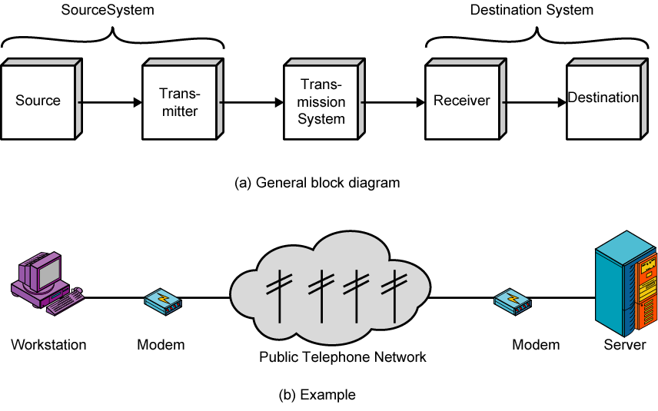
Figure: Key Elements of Data Communication

Slide 6
A Data Communications Model
Suppose that the input device and transmitter are components of a personal computer. The user of the PC wishes to send a message m to another user.
The user activates the electronic mail package on the PC and enters the message via the keyboard (input device).
The character string is briefly buffered in main memory, which can be view as a sequence of bits (g) in memory.
The personal computer is connected to some transmission medium, such as a local network or a telephone line, by an I/O device (transmitter), such as a local network transceiver or a modem.
The input data are transferred to the transmitter as a sequence of voltage shifts [g(t)].
The transmitter is connected directly to the medium and converts the incoming stream [g(t)] into a signal [s(t)] suitable for transmission.

Slide 7
The transmitted signal s(t) presented to the medium is subject to a number of impairments, before it reaches the receiver.
Thus, the received signal r(t) may differ from s(t).
The receiver will attempt to estimate the original s(t), based on r(t) and its knowledge of the medium, producing a sequence of bits g’(t).
These bits are sent to the output personal computer (as a block of bits)
The destination system will attempt to determine if an error has occurred and, if so, cooperate with the source system to eventually obtain a complete, error-free block of data.
These data are then presented to the user via an output device, such as a printer or screen. The message (m’) as viewed by the user will usually be an exact copy of the original message (m)

Slide 8
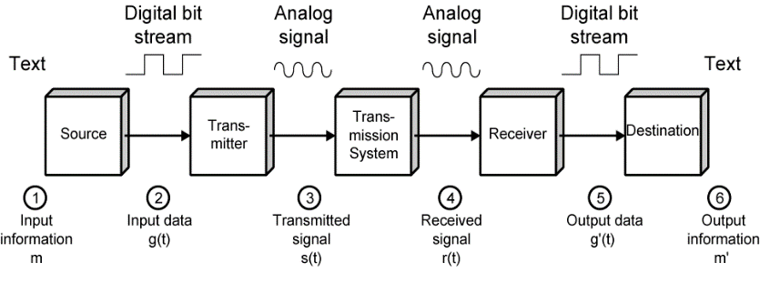
Figure: A Data Communications Model

Slide 9
Data Representation
A binary digit or bit has only two states, “0" and "I" and can represent only two symbols, but even the simplest form of communication between computers requires a much larger set of symbols, e.g.
52 capital and small letters,
10 numerals from 0 to 9
punctuation marks and other special symbols, and
terminal control characters-Carriage Return (CR), Lane Feed (Lr).

Slide 10
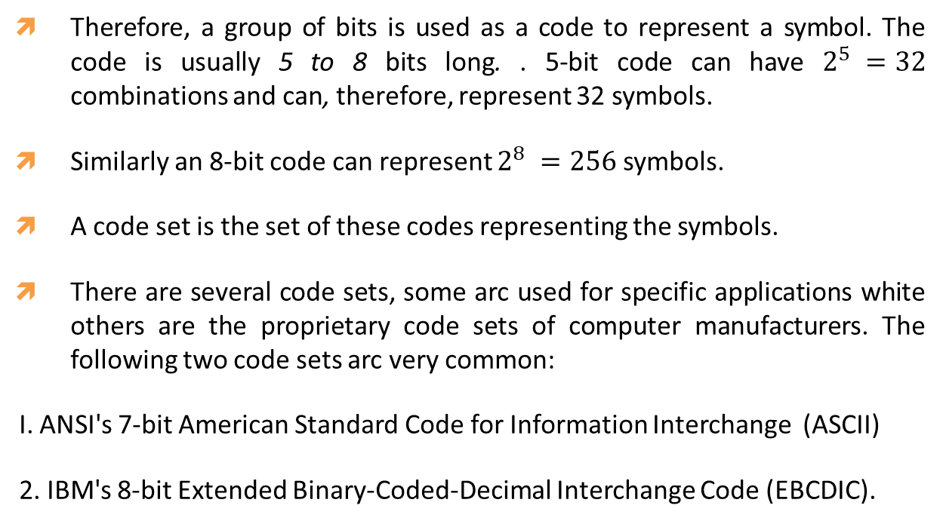
Therefore, a group of bits is used as a code to represent a symbol. The code is usually 5 to 8 bits long. . 5-bit code can have $2^{5} =32$ combinations and can, therefore, represent 32 symbols.
Similarly an 8-bit code can represent $2^{8} =256$ symbols.
A code set is the set of these codes representing the symbols.
There are several code sets, some arc used for specific applications white others are the proprietary code sets of computer manufacturers. The following two code sets arc very common:
I. ANSI's 7-bit American Standard Code for Information Interchange (ASCII)
2. IBM's 8-bit Extended Binary-Coded-Decimal Interchange Code (EBCDIC).

Slide 11
American Standard Code for Information Interchange (ASCII)
ASCII is the most common code set and is used worldwide.
It is, 7 bit code and all the possible 128 codes have defined meaning. The code set consists of following symbols:
96 graphic symbols (columns 2 to 7), comprising 94 printable characters, SPACE. And Delete characters
32 control symbols (columns 0 and I).

Slide 12
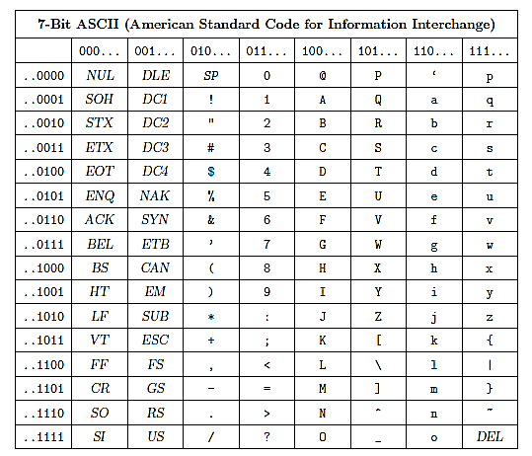

Slide 13
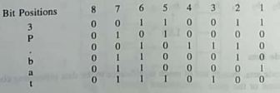
The binary representation of a particular character can be easily determined from its hexadecimal coordinate. For example, the coordinate of character "K" are (4, B) and, therefore, it’s binary code is 100 1011.
EXAMPLE 1:
Represent the message “3P.bat" in ASCH code. The eighth bit may be kept as “0''.
Solution:

Slide 14
Data Transmission
Bytes: Byte is a group or bits which is considered as a single unit during processing. It is usually eight bits long though its length may be different . A character code, e.g., 1001011 of ASCII, is a byte having a defined meaning "K", but it should be noted that there may be bytes which are not elements of any standard code set.
There is always need to exchange data, commands and other control information between a computer and its terminals or between two computers. This information is in the form of bits.
Data transmission refers to movement of the bits over some physical medium connecting two or more digital devices. There are two options of transmitting the bits, namely,
Parallel transmission
Serial transmission.

Slide 15
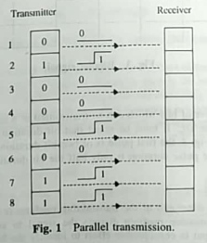
parallel transmission: Here all the bits of a byte are transmitted simultaneously on separate wires and multiple circuits interconnecting the two devices are, therefore, required. It is practical only if the two devices, e.g., a computer and its associated printer are close to each other.

Slide 16

Serial transmission: Here bits are transmitted serially one after the other . The least significant bit (LSB) is usually transmitted first. Note that as compared to parallel transmission, serial transmission requires only one circuit interconnecting the two devices. Therefore. Serial transmission is suitable for transmission over long distance.

Slide 17
Serial Transmission Example- Write the bit transmission sequence of the message “3p.bat”.
Solution:
3 | p | . | b | a | t
11001100 | 00001010 | 01110100 | 01000110 | 10000110 | 00101110

Slide 18
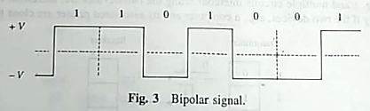
Bipolar Signal - Bits are transmitted as electrical signals over the interconnecting wires. The two binary states “1” and “0” are represented by two voltage levels. If one of these states is assigned 0 volt level, the transmission is termed unipolar and if we choose to represent a binary "1" by , say, a positive voltage +V volts and n binary “o'' by a negative voltage -V volts, the transmission is said to be bipolar.
The following figure shows the bipolar waveform of the character "K". Bipolar transmission is preferred because the signal does not have any DC component. The transmission media usually do not allow the DC signals to pass through.

Slide 19
Mode of Serial transmission
Serial transmission can be two types:
1. Synchronous Transmission
2. Asynchronous Transmission

Slide 20
In synchronous transmission, bits are sent one after another without start or stop bits or gaps. It is the responsibility of the receiver to group the bits.
Sender
Direction of data flow
Receiver
00010000 11110111 11110110 11111011 1 1011
Figure: Synchronous transmission

Slide 21
In synchronous transmission, one start bit (0) at the beginning, followed by a byte and one or two stop bits (1) at the end of each byte. There may be a gap between each byte. This is also known as framing.
Generally use in low speed data transmission.
Send one start bit (0) at beginning of the byte and one or two stop bits (1) at end of each byte.
There are variable–length gaps between each byte.

Slide 22
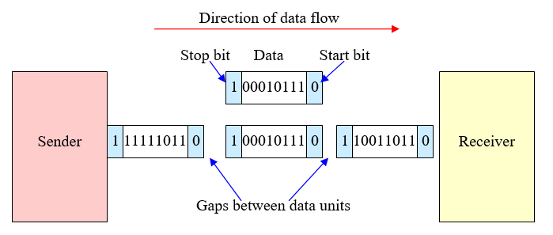
Figure: Asynchronous transmission

Slide 23
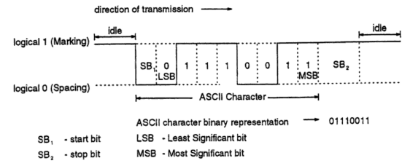
Figure: Asynchronous Transmission Details

Slide 24
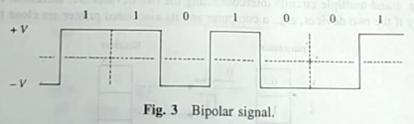
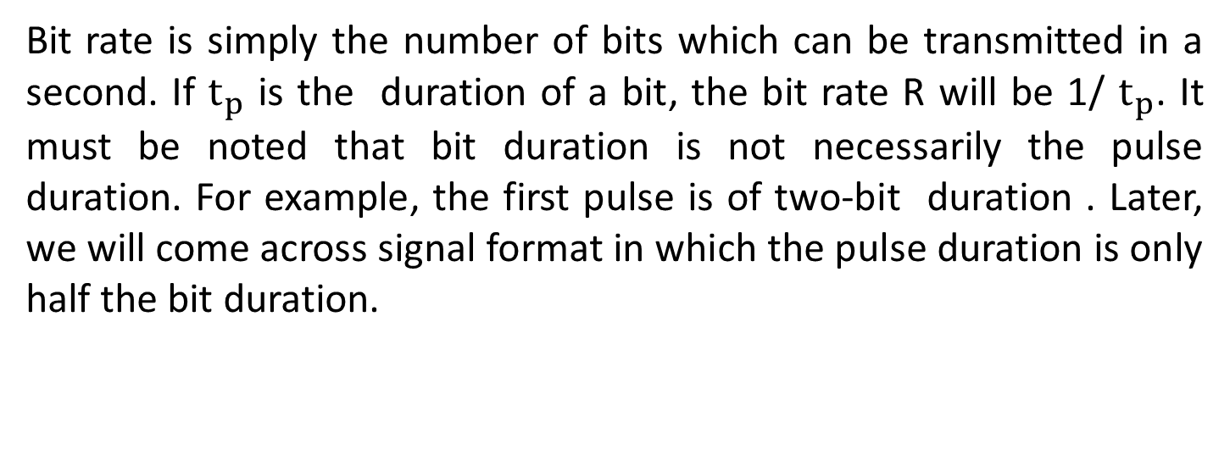
Bit Rate
Bit rate is simply the number of bits which can be transmitted in a second. If $t_{p}$ is the duration of a bit, the bit rate R will be 1/ $t_{p}$. It must be noted that bit duration is not necessarily the pulse duration. For example, the first pulse is of two-bit duration . Later, we will come across signal format in which the pulse duration is only half the bit duration.

Slide 25
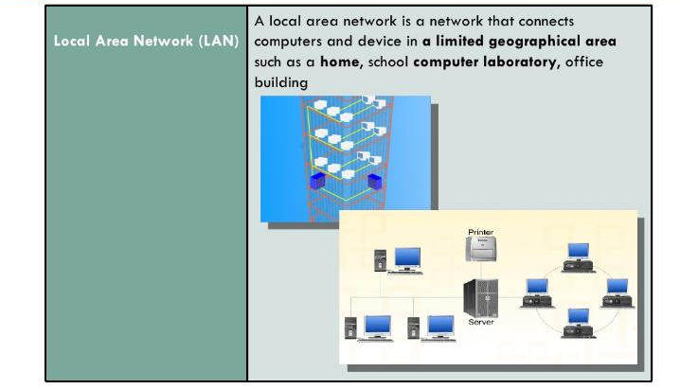
Types of Networks

Slide 26
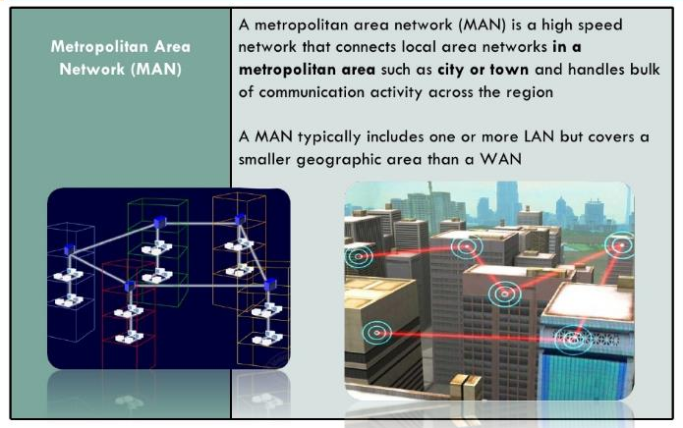

Slide 27
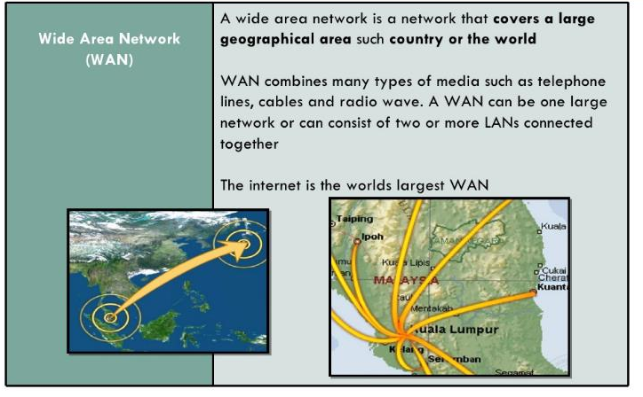

Slide 28
Books
Forouzan, B. A. "Data Communication and Networking. Tata McGraw." (2005).
Prakash C. Gupta, “Data communications”, Prentice Hall India Pvt.

Slide 29
References
1. Prakash C. Gupta, “Data communications”, Prentice Hall India Pvt.
2. William Stallings, "Data and Computer Communications”, Pearson
3. Forouzan, B. A. "Data Communication and Networking. Tata McGraw." (2005).

